Slide 1
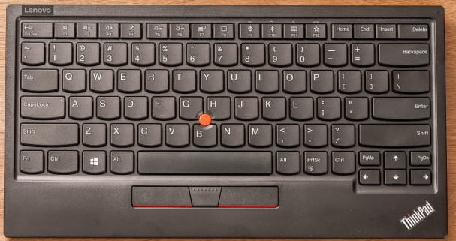
Esc – close or cancel
W – select front sail
R – restart game
F11 – full screen in/out
P – pause / play toggle
- (minus) for smaller buttons
+ (plus) for larger buttons
S – select main sail
A – toggle ANCOR
Up arrow – release sails
Enter – OK or close
X – track boat/world
? / - show this help info
Left Shift – hit rudder to the left
Right Shift – hit rudder to the right
Z – zoom in/out
Page Down – lower the keel
Page Up – raise the keel
Cntr + C – quit the game
Legend:
Navigations
Game controls
Left arrow – rudder to left
Down arrow – pull sails
Right arrow – rudder to right
Dialogs control

Slide 2
Z
Z
F11

